Slide 1
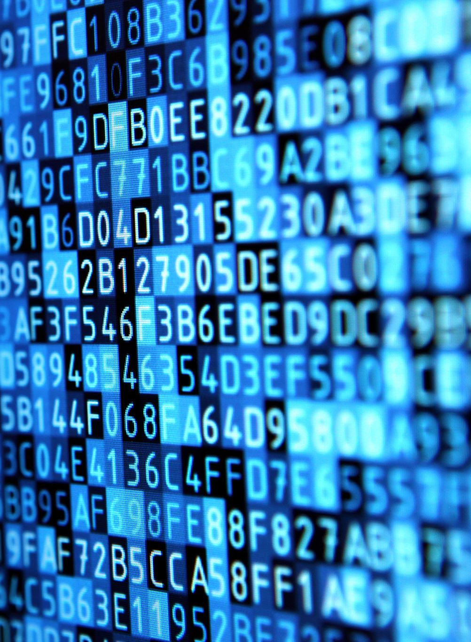
DIGITAL CLOCK USING PYTHON

Slide 2
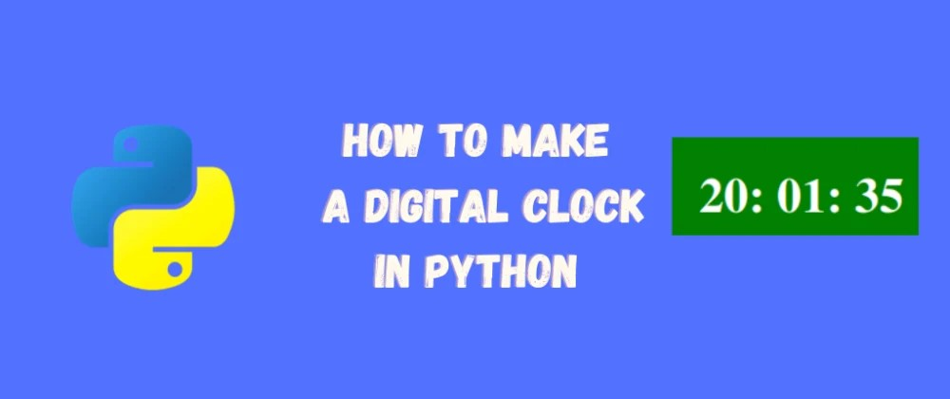

Slide 3
CONTENT
ABSTRACT
INTRODUCTION
PYTHON
IMPORT LIBRARIES
DESIGNING THE APPLICATION WINDOW
DIGITAL CLOCK FUNCTION
RUNNING THE APPLICATION
OUTPUT

Slide 4
ABSTRACT
How to build and design your digital clock window using python. This is a simple project to get started with Tkinter, which is a built-in package that comes with Python. Tkinter is basically a graphical user interface package. It has great features that can be used to create simple applications. And today we will use it to create our digital clock.The great part of building your own digital clock is you can customize it as you wish. From text font to background color, all the features are available to be customized.

Slide 5
INTRODUCTION
This is a simple project to get started with Tkinter, which is a built-in package that comes with Python. Tkinter is basically a graphical user interface package. It has great features that can be used to create simple applications. And today we will use it to create our digital clock.
The great part of building your own digital clock is you can customize it as you wish. From text font to background color, all the features are available to be customized.

Slide 6
PYTHON
Python is a general-purpose programming language that is becoming ever more popular for analyzing data. Python also lets you work quickly and integrate systems more effectively. Companies from all around the world are utilizing Python to gather bits of knowledge from their data.

Slide 7
IMPORT LIBRARIES
We will use two libraries in this project. And both of them come with Python, which means we don’t have to install them. These kind of libraries is called Python built-in packages.
The main package we will use is Tkinter. You can learn more about Tkinter from here, the official documentation page.
So for this step, all we need to do is to import them to our program:
from tkinter import Label, Tk import time

Slide 8
DESIGNING THE APPLICATION WINDOW
In this step, we will first define the window panel using Tkinter package. And after that, we will define the text design that we want to use for the digital clock.
Define the Window
As mentioned earlier, we will use Tkinter package. Tkinter is can be defined as Tk. And after defining it, we will customize it.
app_window = Tk() app_window.title("My Digital Time") app_window.geometry("350x150") app_window.resizable(0,0)

Slide 9
DIGITAL CLOCK FUNCTION
If we are working on an application project, functions are the best way to make things work. Functions are also great because they make the program more structured and easier to understand. Alright, let’s define our digital clock function then:
def digital_clock(): time_live = time.strftime("%H:%M:%S") label.config(text=time_live) label.after(200, digital_clock)

Slide 10
RUNNING THE APPLICATION
This is the final step of our application project. As we know functions will not run unless you call them. To trigger the application, we will call the function. Let’s run the application:
digital_clock() app_window.mainloop()

Slide 11
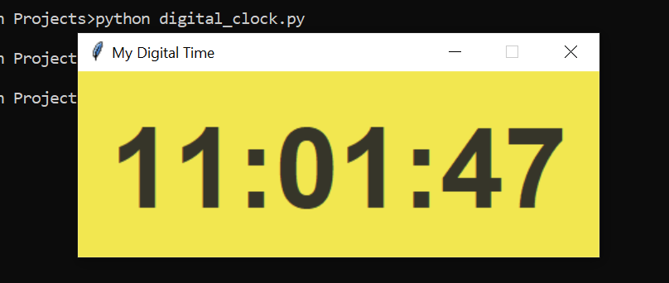
OUTPUT

Slide 12
THANK YOU

